Slide 1

Work-let Name: AI/ML Based Network Device Software upgrade in SDN Controlled Network
Worklet Details
Worklet ID: CSW23VIT
College Name: VIT, Vellore Campus
Milestones: (KPIs)
Milestone1: Prediction using BiLSTM and SARIMA
Milestone2: Use case 1 completed
Milestone3: Use case 2 and 3 completed
Milestone4: Use case 4 completed
Milestone5: Introduction and Literature review completed
Next Steps
Draft paper generation
Date: xxxxxxx

Slide 2
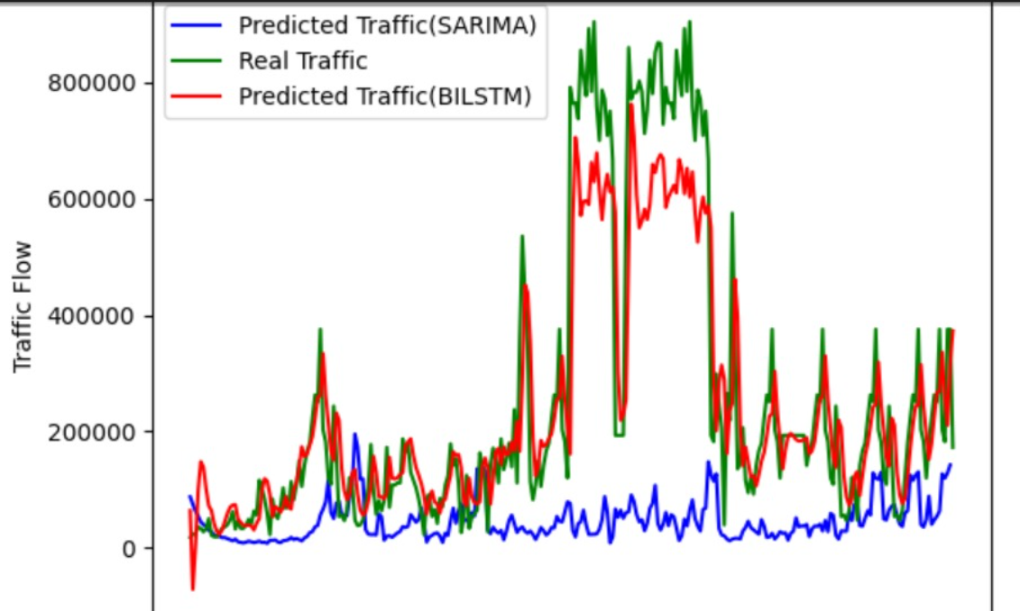
Work-let Name: AI/ML Based Network Device Software upgrade in SDN Controlled Network
Milestone1: Prediction using BiLSTM and SARIMA
Worklet ID: CSW23VIT
College Name: VIT, Vellore Campus
Date: xxxxxxx

Slide 3
Work-let Name: AI/ML Based Network Device Software upgrade in SDN Controlled Network
Worklet ID: CSW23VIT
College Name: VIT, Vellore Campus
Milestone2: Use case 1 completed
Date: xxxxxxx

Slide 4
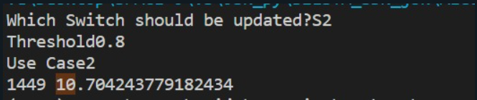
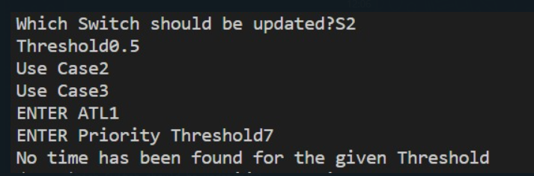
Work-let Name: AI/ML Based Network Device Software upgrade in SDN Controlled Network
Milestone3: Use case 2 and 3 completed
Use case 2 completed
Worklet ID: CSW23VIT
College Name: VIT, Vellore Campus
Use case 3 completed
Date: xxxxxxx

Slide 5
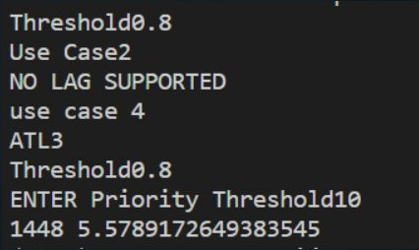
Work-let Name: AI/ML Based Network Device Software upgrade in SDN Controlled Network
Worklet ID: CSW23VIT
College Name: VIT, Vellore Campus
Milestone4: Use case 4 completed
Date: xxxxxxx

Slide 6
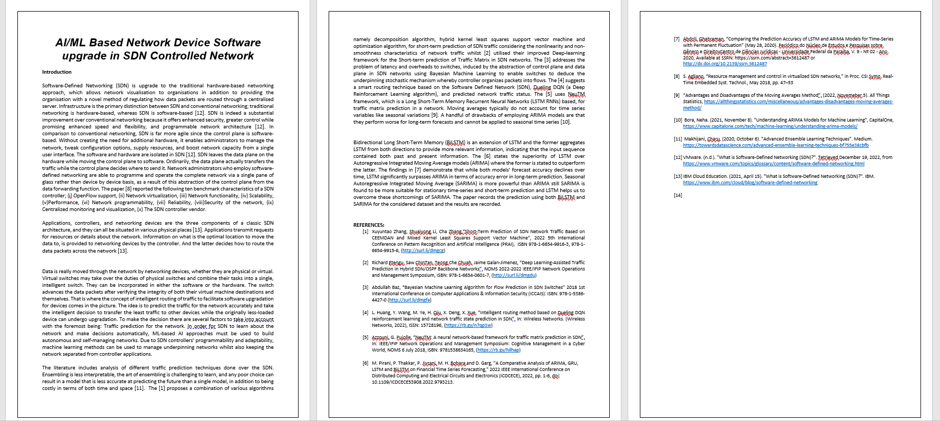
Work-let Name: AI/ML Based Network Device Software upgrade in SDN Controlled Network
Milestone5: Introduction and Literature review completed
Worklet ID: CSW23VIT
College Name: VIT, Vellore Campus
Date: xxxxxxx

